Slide 1

The Blockchain Revolution Pierre-Alexandre Balland
Utrecht University
ANITI
Notes:
Have you heard about:
Bitcoin
Cryptocurrencies
Blockchain
Basic understanding of the space?

Slide 2
Blockchain is taking the world by storm
Notes:
Organize private trainsings, products, inve strat

Slide 3
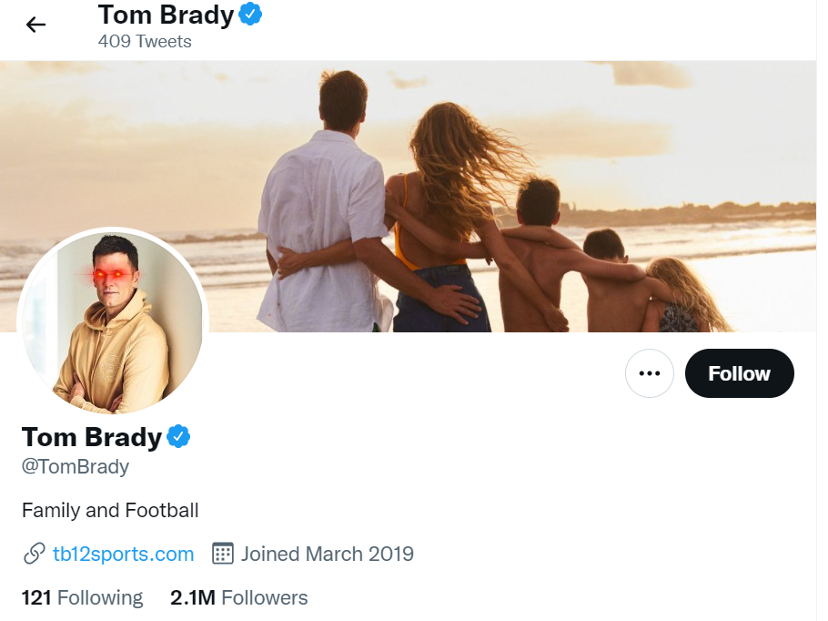

Slide 4
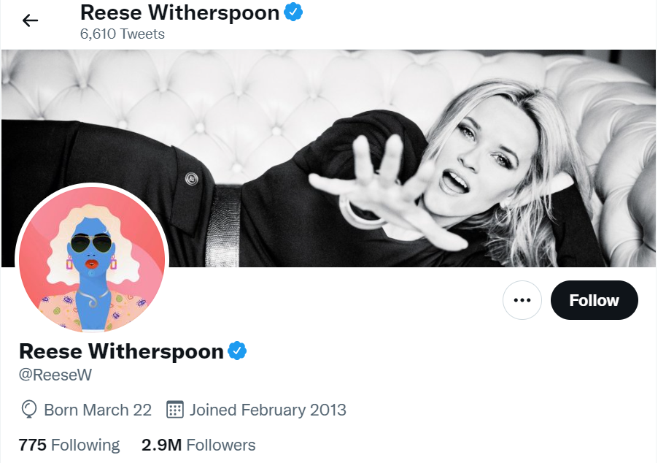

Slide 5
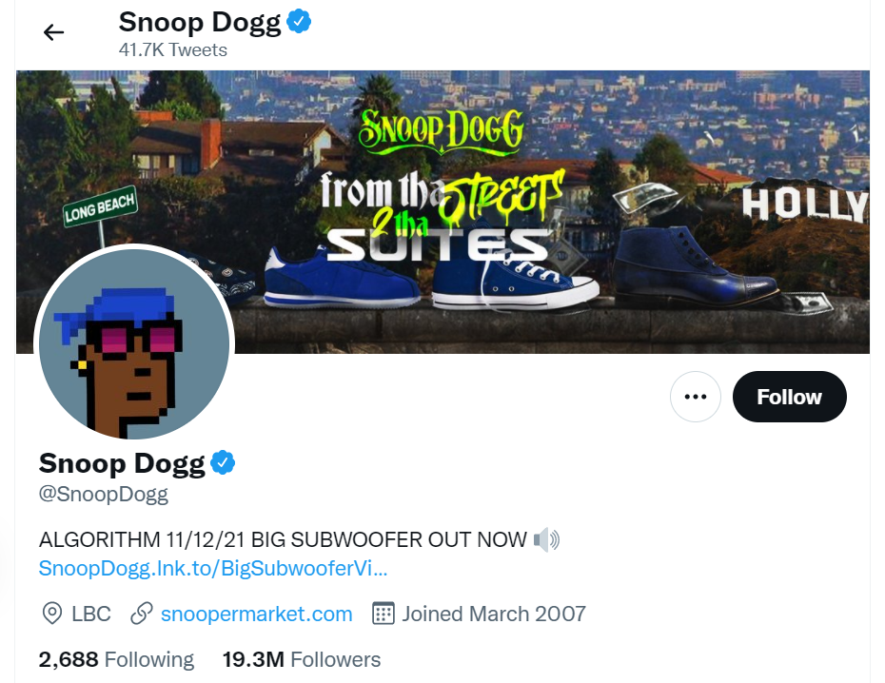

Slide 6
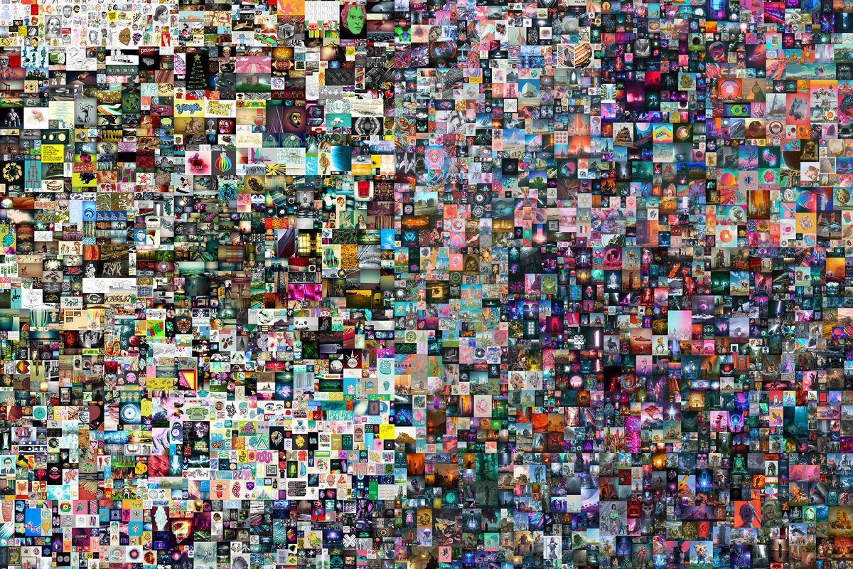

Slide 7
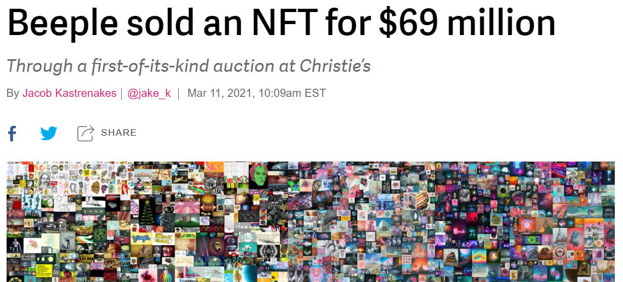
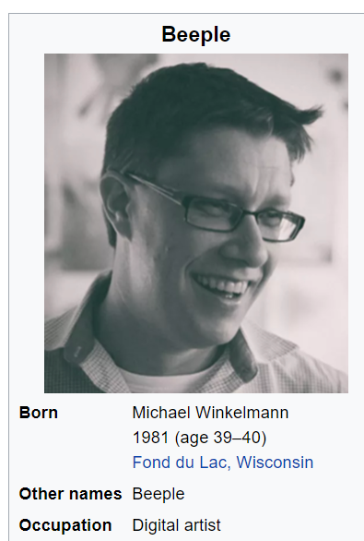

Slide 8
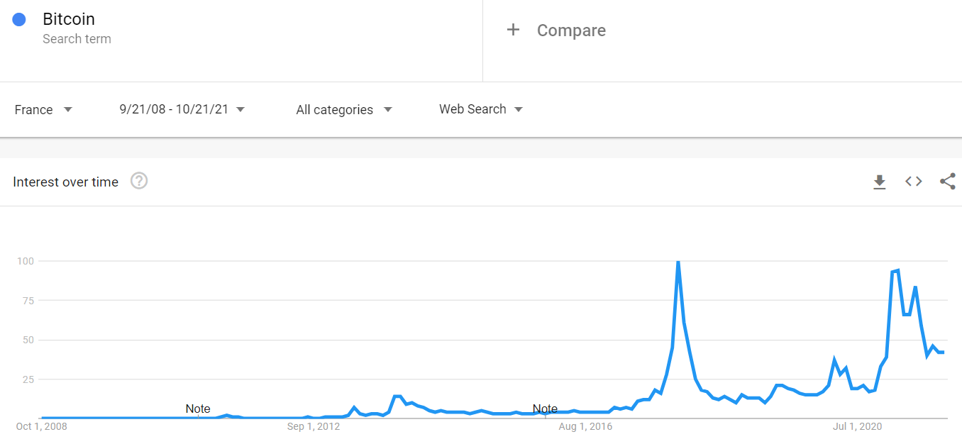

Slide 9
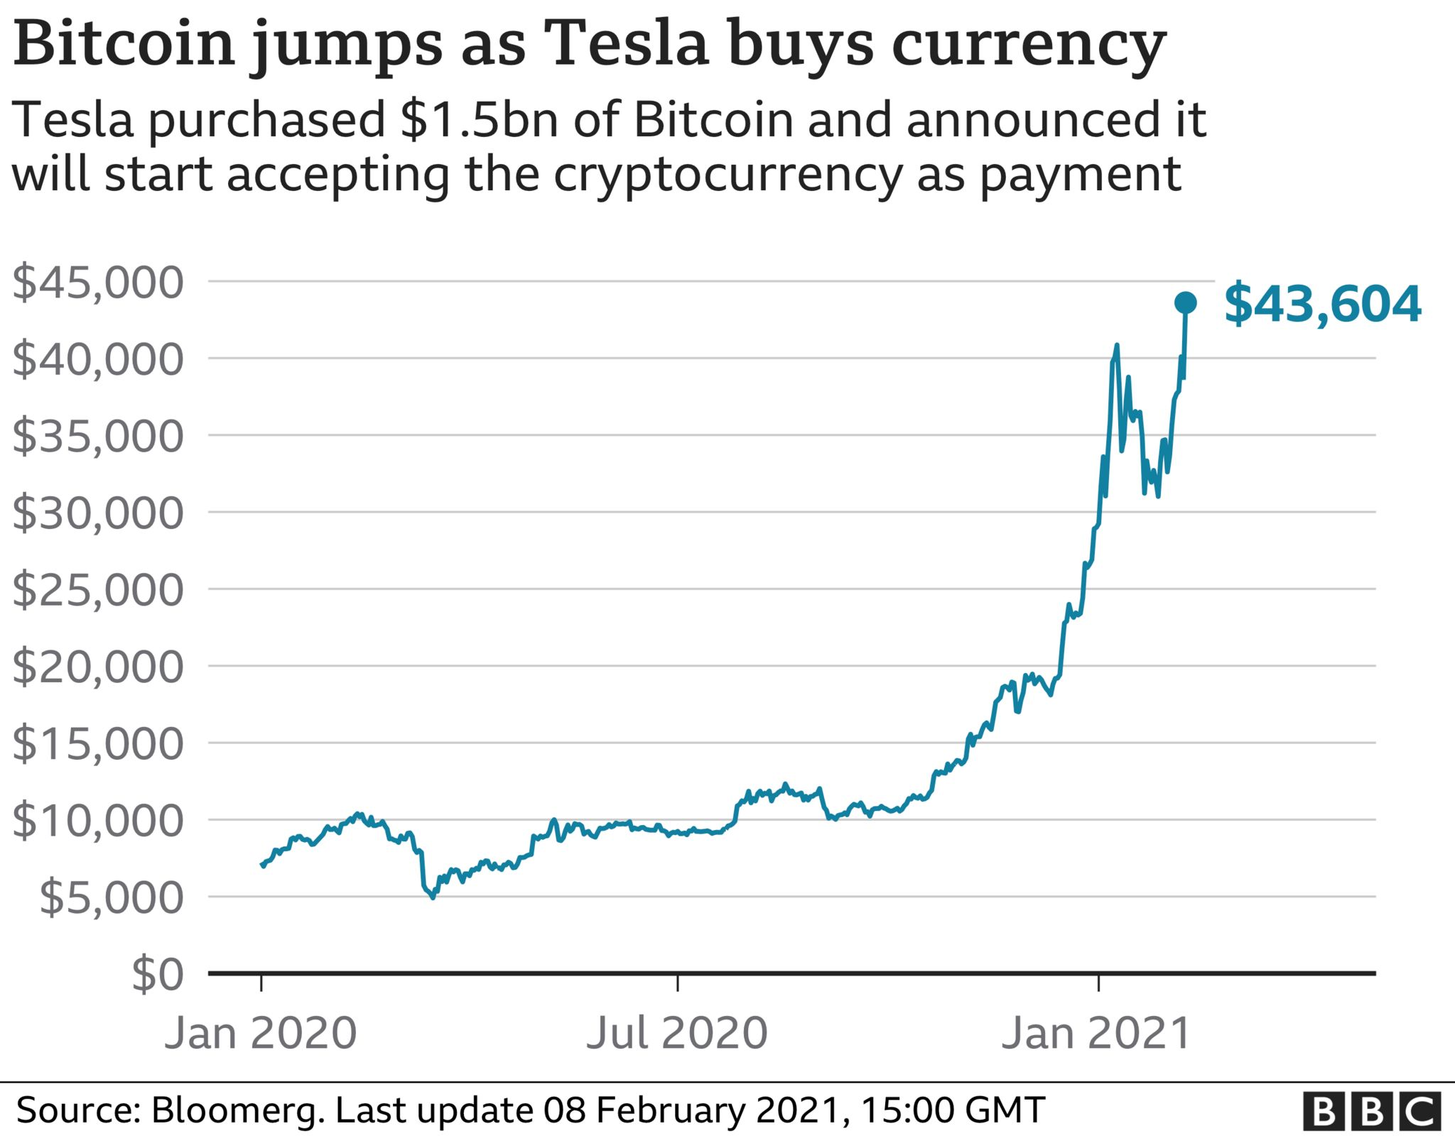
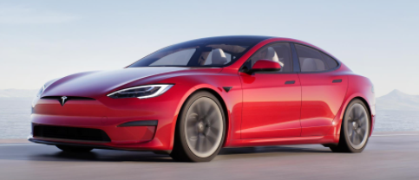

Slide 10
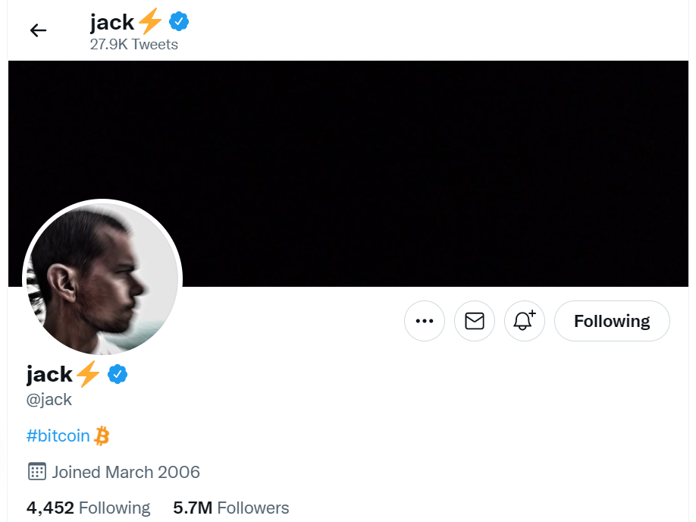

Slide 11
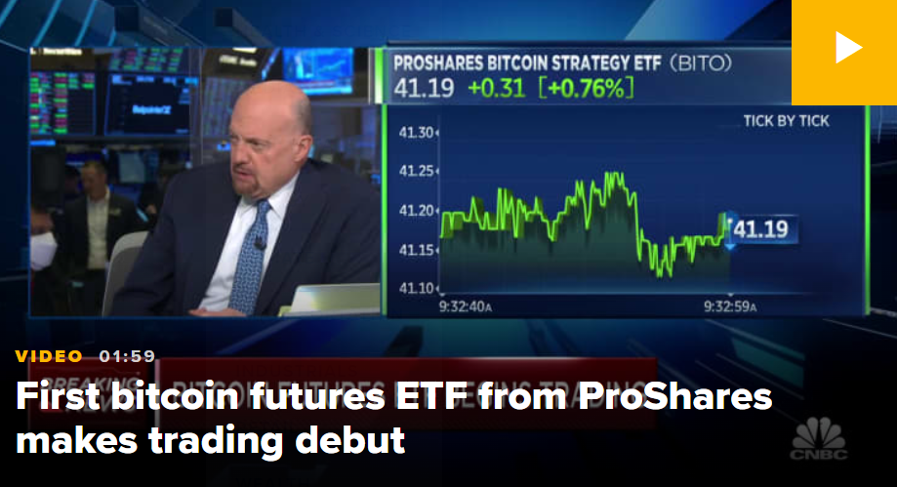

Slide 12
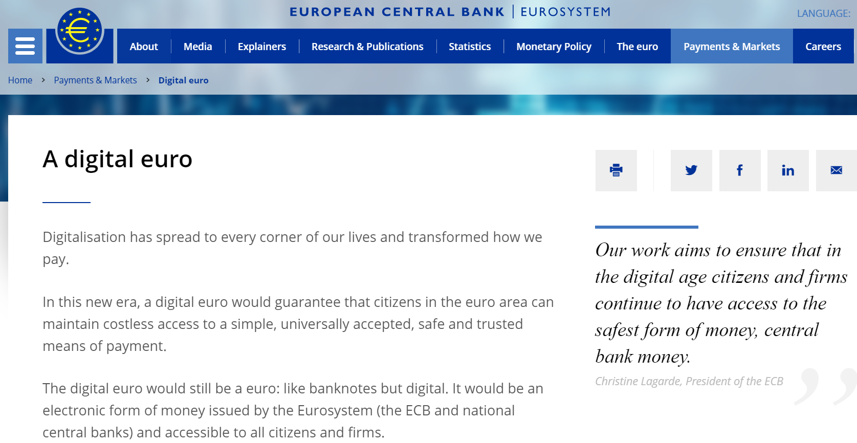

Slide 13
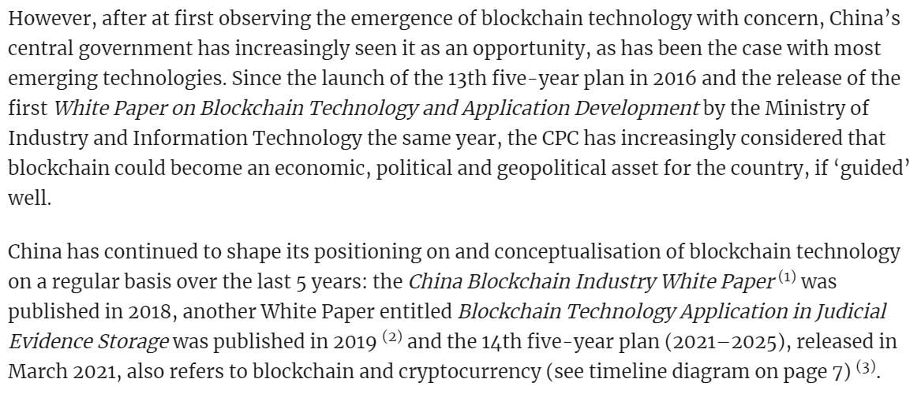
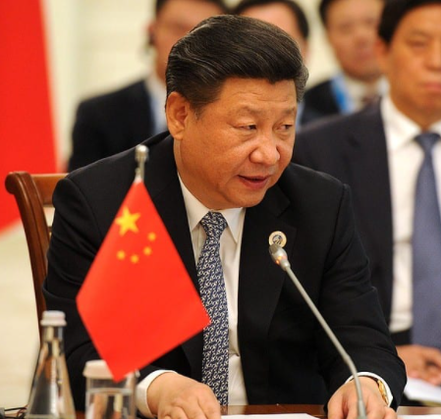

Slide 14
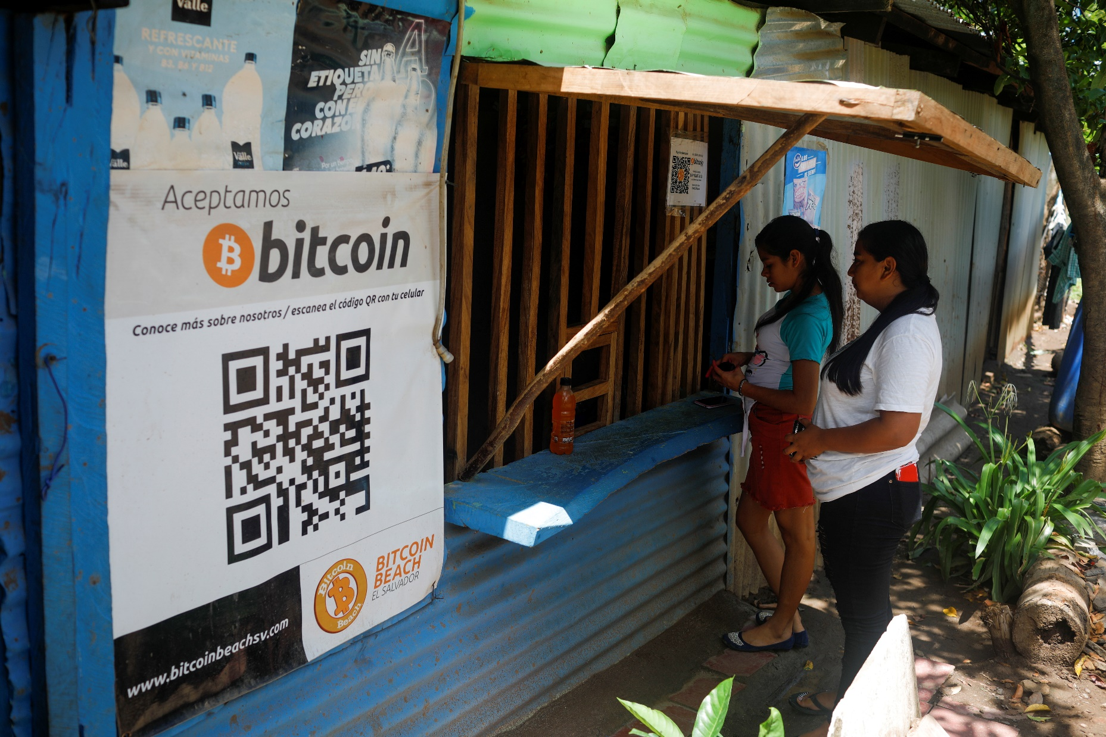
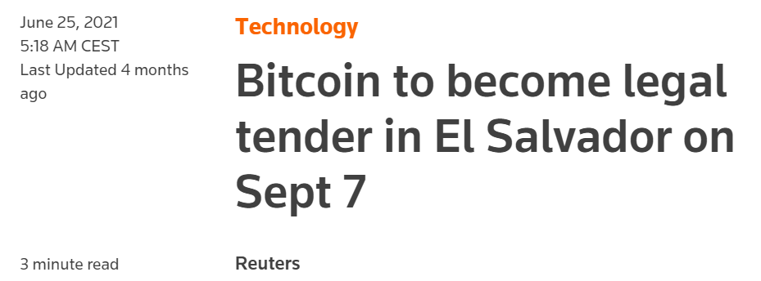

Slide 15
The blockchain space: bubble or future of technology and society?
Notes:
Organize private trainsings, products, inve strat

Slide 16
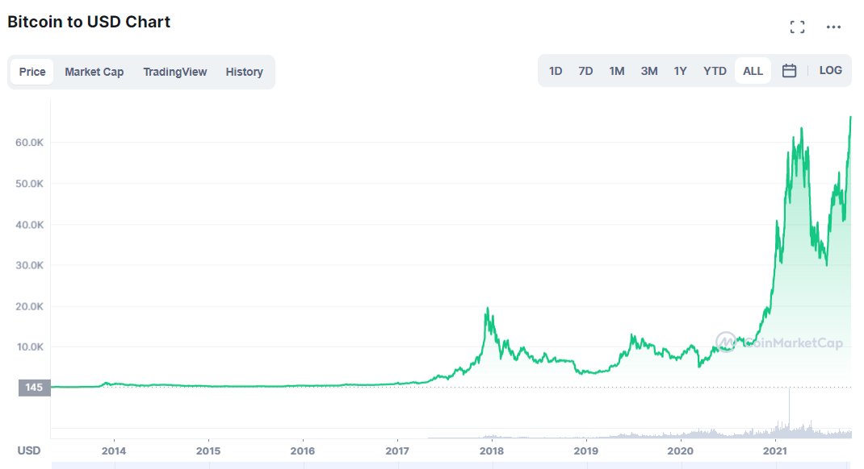

Slide 17
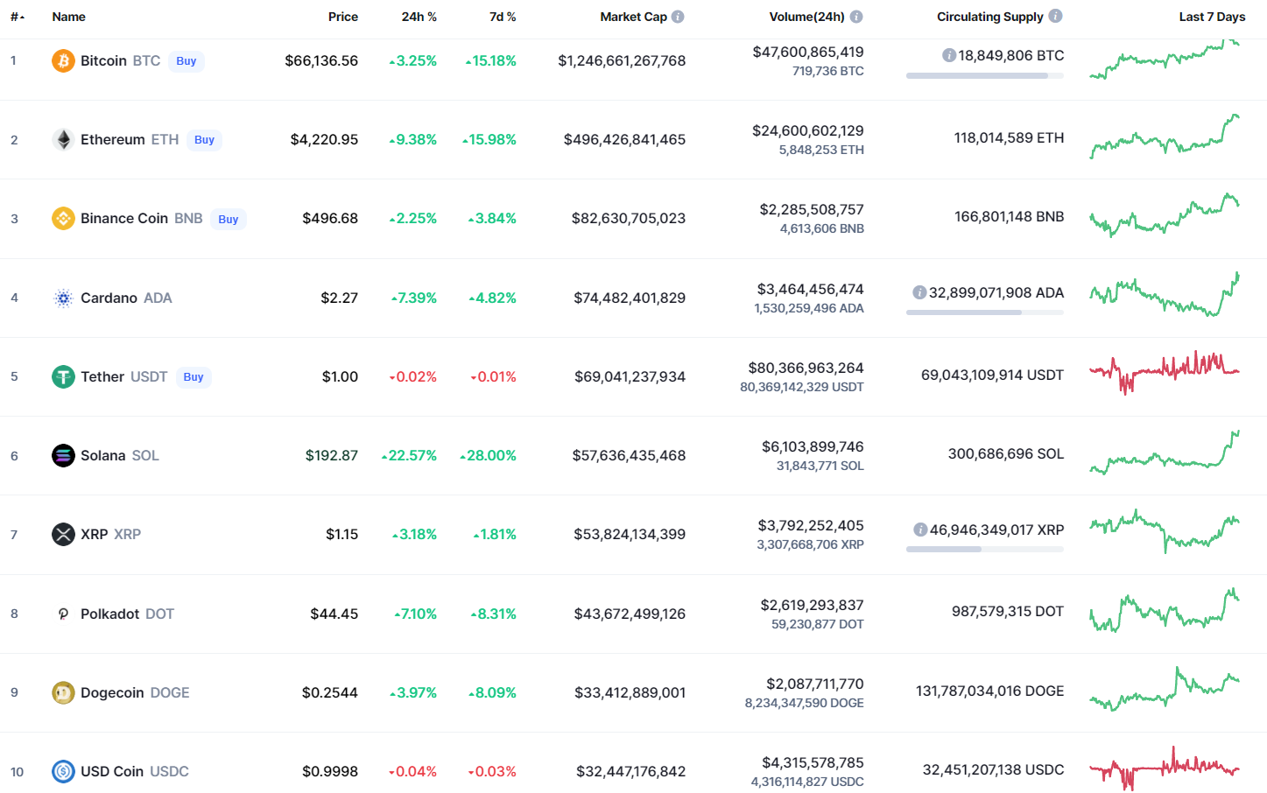

Slide 18
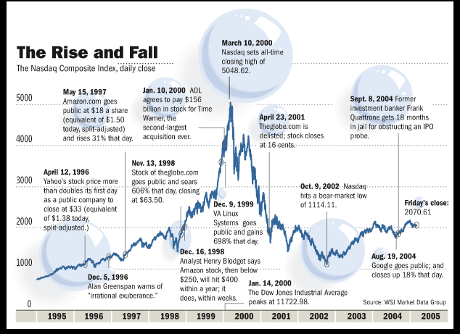

Slide 19

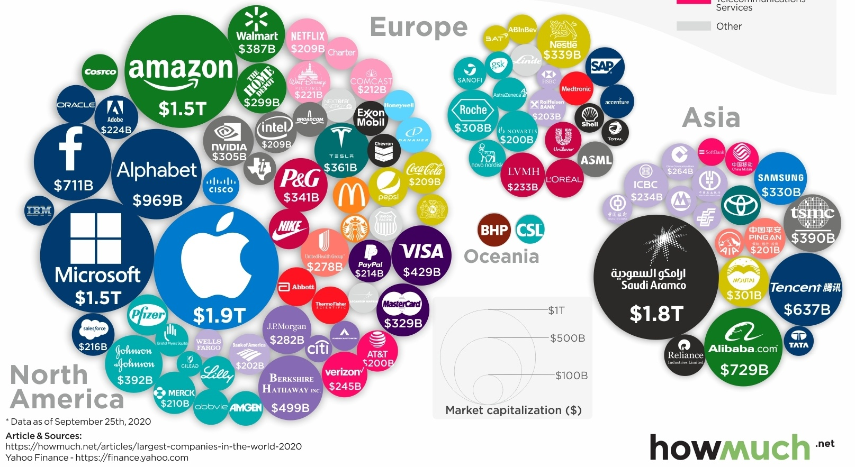
Top 100 companies by market cap
Notes:
July 2017, China’s State Council issued the New Generation Artificial Intelligence Development Plan (AIDP)

Slide 20
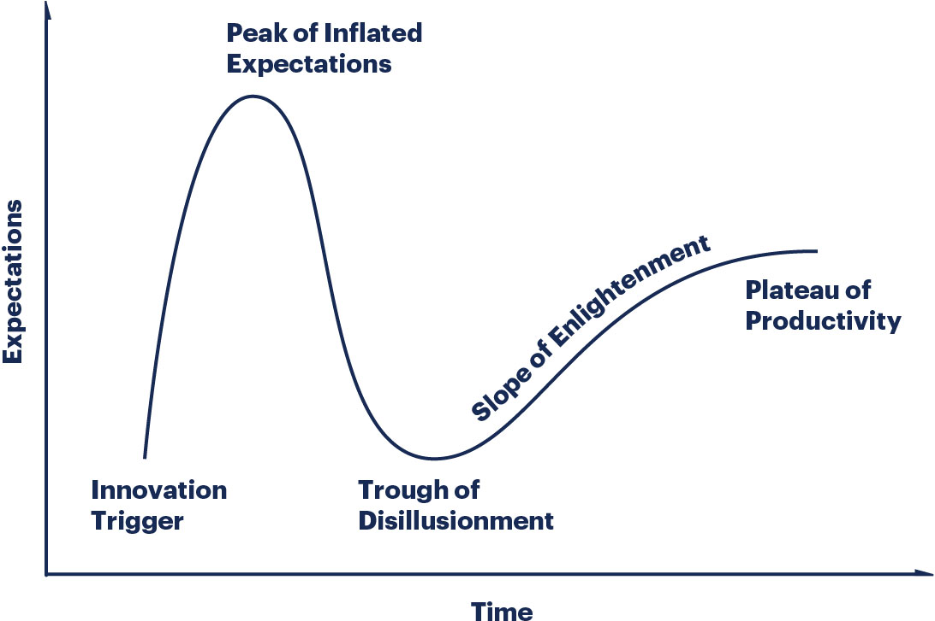
Gartner Hype Cycle

Slide 21
How does a blockchain work?
Notes:
Organize private trainsings, products, inve strat

Slide 22
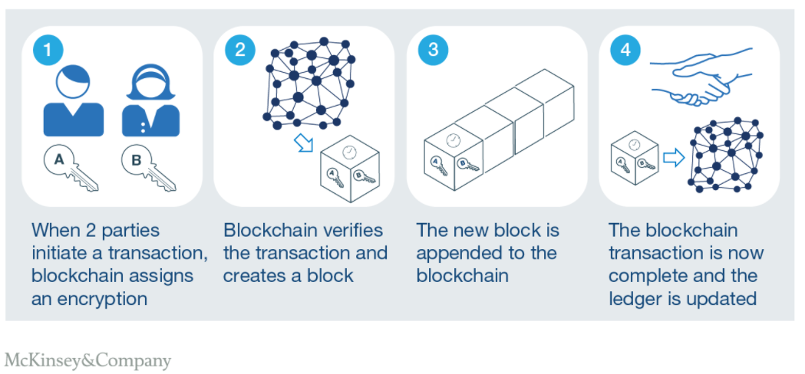

Slide 23
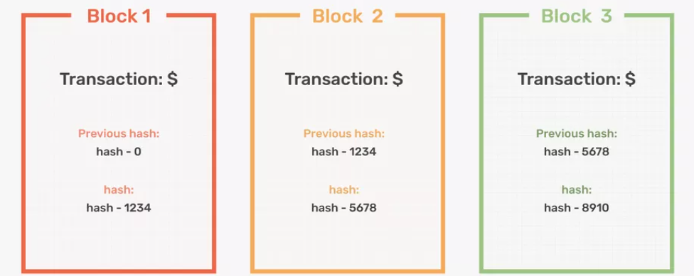

Transaction data is stored in blocks linked to form a chain

Slide 24
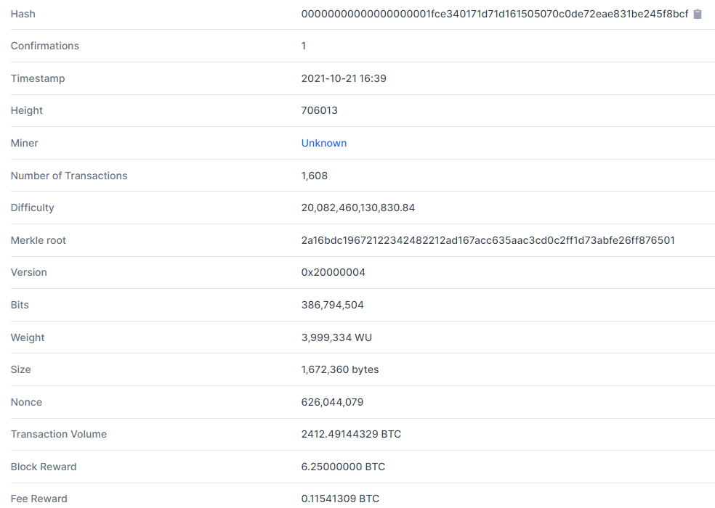

Slide 25
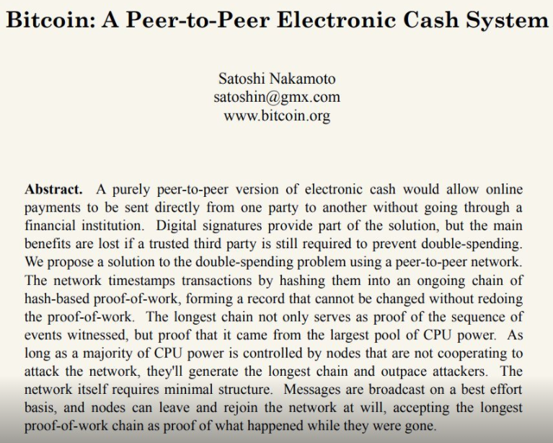

Slide 26
Bitcoin is a type of unregulated digital currency whose transactions ledger is maintained by blockchain technology
Blockchain revolutionizes the way information can be shared on the internet because the digital data can't be altered or deleted (internet of information VS internet of value)

Slide 27
Blockchain reduces transactions costs
Blockchain technology makes it very cheap to audit digital transactions
Problem, limitations & hacks are all at the interface of the physical and digital space (when data is digitally recorded, accessed or inputted)
Blockchain changes our approach to digital privacy - it allows to avoid disclosing personal information to third parties in a centralized way & allows for data ownership (licensing and use)
Notes:
Today: we audit transaction by sharing a lot of personal data

Slide 28
Decentralization of the internet (Web 3.0)
Notes:
Organize private trainsings, products, inve strat

Slide 29
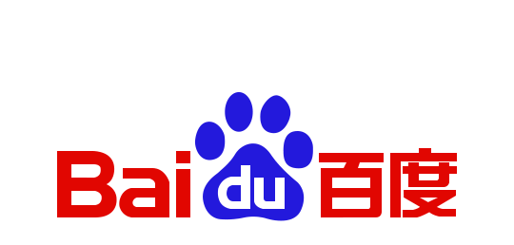



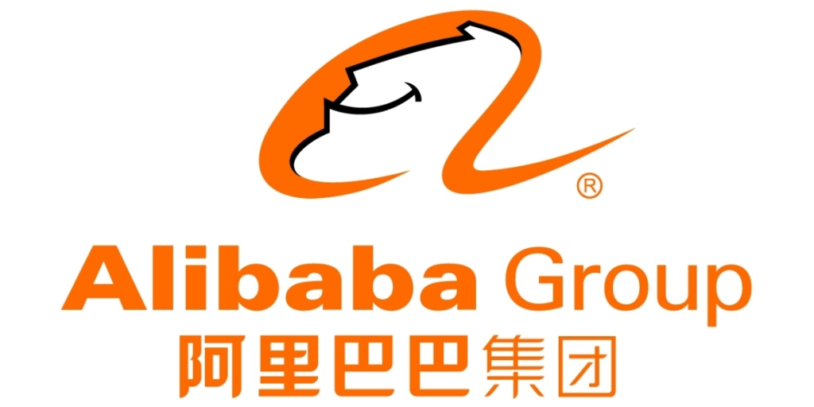
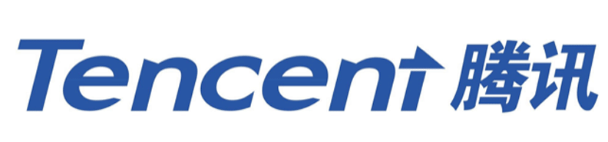
Market power in digital platforms

Slide 30

Reinforcing Feedback Loops
Google gets
more data
More customers
use Google
Google’s algorithm
gets better
Google’s offers a
better product

Slide 31
A few blockchain use cases
Notes:
Organize private trainsings, products, inve strat

Slide 32
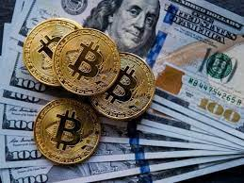
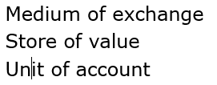
Money

Slide 33
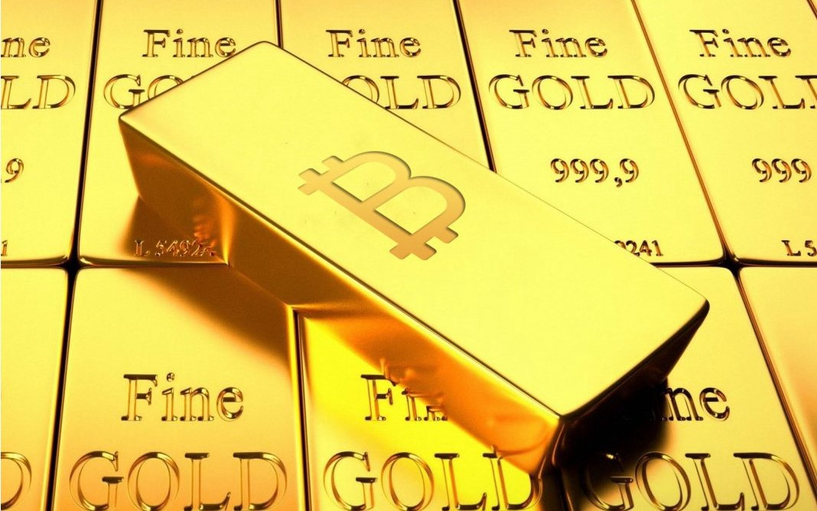
Digital gold

Slide 34
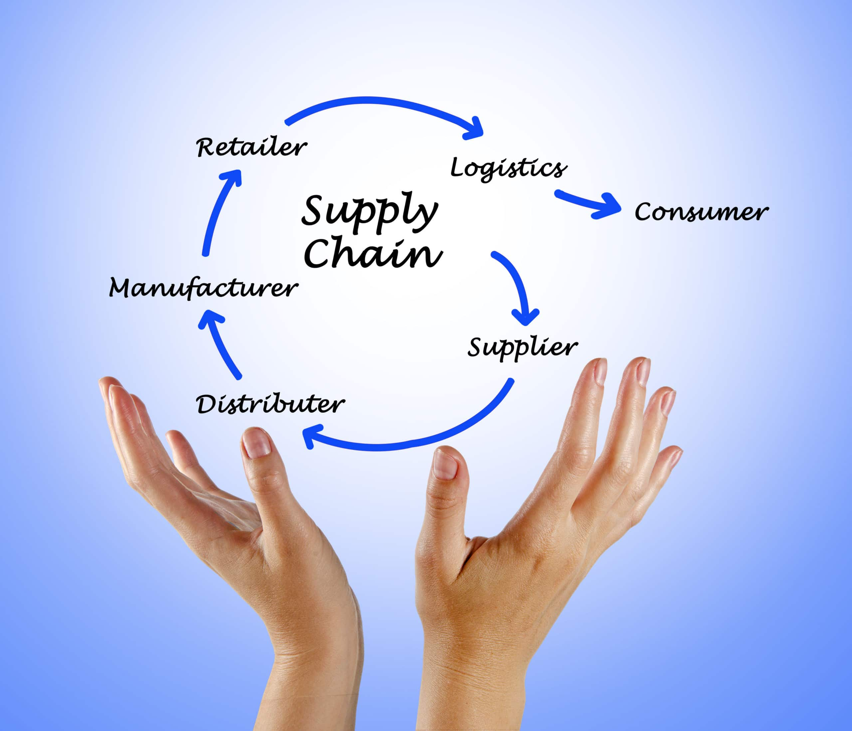
Supply chain management

Slide 35
NFTs anyone?
Notes:
Organize private trainsings, products, inve strat

Slide 36
What are NFTs and why do they matter?
Two types of tokens: fungible and non-fungible
NFTs are used to represent unique digital assets (painting VS a dollar)
NFTs ownership can be automatically verified
They can easily be traded on a secondary market
NFTs have the potential to limit the use of digital products that could otherwise be duplicated infinitely
NFTs will allow to digitalize all unique physical assets

Slide 37
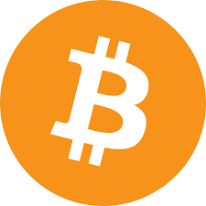

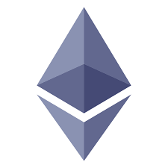
Blockchain is the other automation revolution
Crypto will:
disrupt every industry by automating transactions
enable the scaling of AI solutions (structured + interoperable data)
increase hyperconnectivity by providing trust at scale

Slide 38
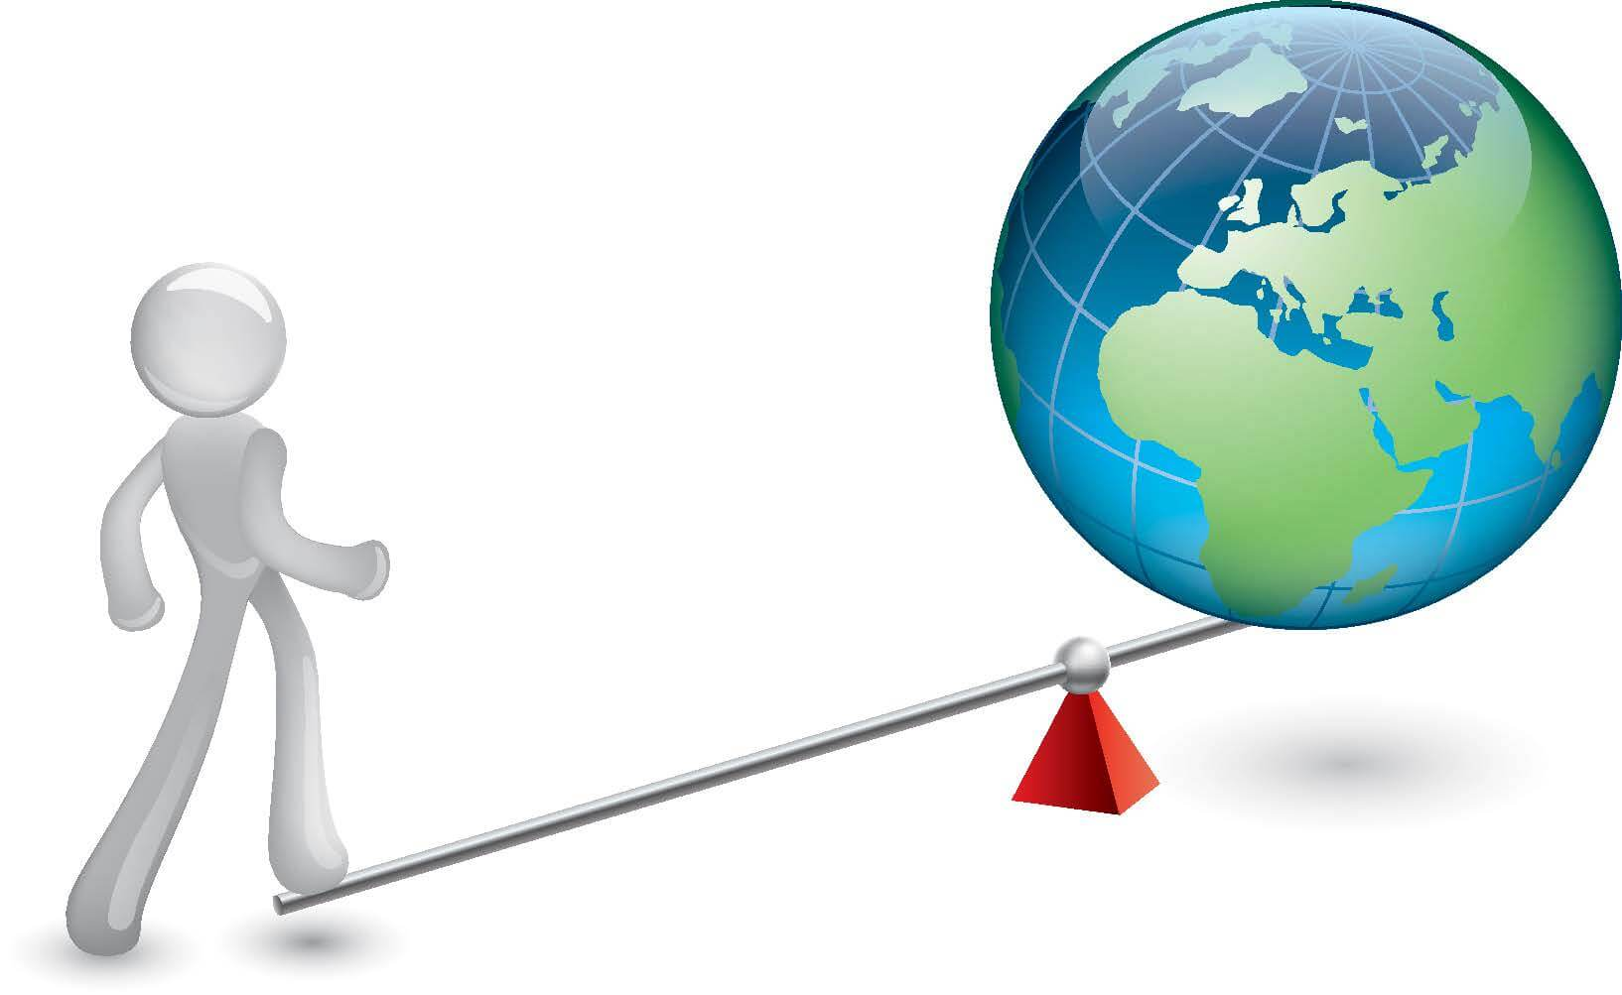
Leveraging complex networks
CODE
Returns are increasingly decoupled from individual efforts
MEDIA
Returns
CAPITAL
LABOR
Leverage
Notes:
Wealth comes from a position of leverage

Slide 39
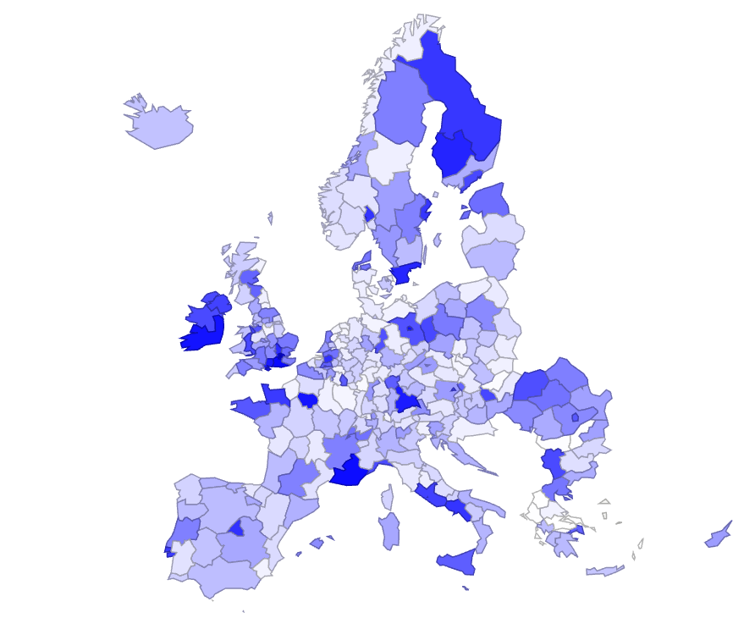
Geography of blockchain technologies

Slide 40
Complex systems are governed by fat tails
Most of the world
is very poor
Most humans are
similarly wealthy
Gaussian
(normal)
distribution
% of population
Very few take it all
The ultra-riches do not exist
Fat tails
Wealth
Wealth
Notes:
Show the math reflection that the more we move to a complex world, the more unequal
We have been trained to think that the world works this way, changes everything

